Slide 1
ART4320 Photography II Color Analysis Project Student Name:
Due date:
Students need to submit their 3 photos, 3 pie charts, and 3 color wheels.
Please delete instructor’s examples before submissions.
1 Monochromatic photo, 1 pie chart, 1 color wheel
1 Analogous photo, 1 pie chart, 1 color wheel
1 complimentary photo, 1 pie chart, 1 color wheel

Slide 2
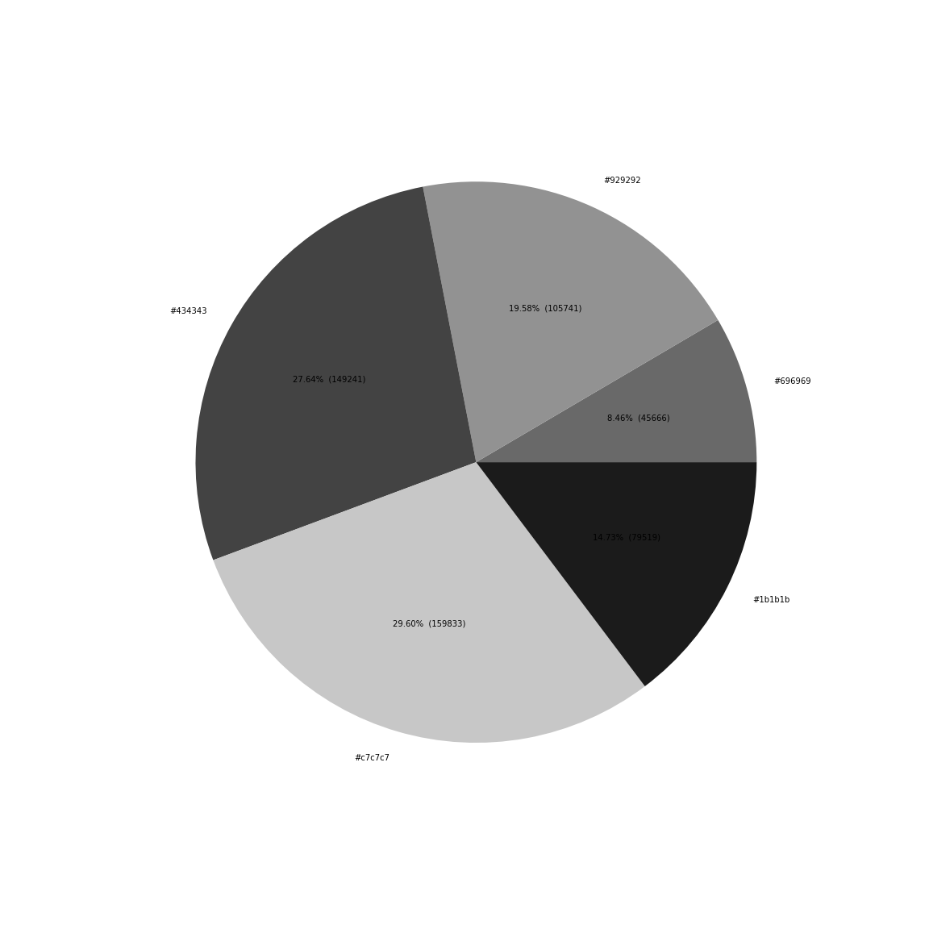
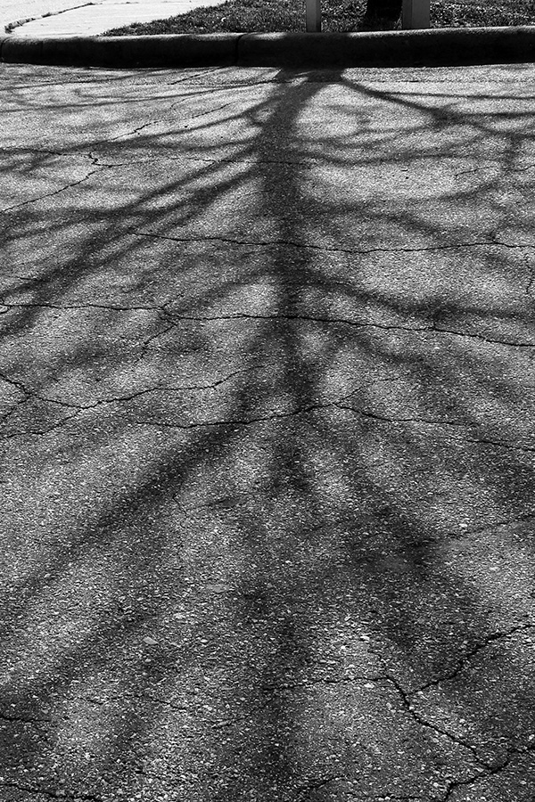
Monochromatic Example (delete later)
Explain color harmony with color combination: Monochromatic color scheme with gray tones.
Write 5 hex colors with percentages: #929292(19.58%), #696969(8.46%), #1b1b1b(14.73%), #c7c7c7(29.60%), #434343(27.64%).
Which color is the most used? #c7c7c7 (29.60%)
What is the brightest color? #c7c7c7 (29.60%)
What is the darkest color? #1b1b1b(14.73%)

Slide 3
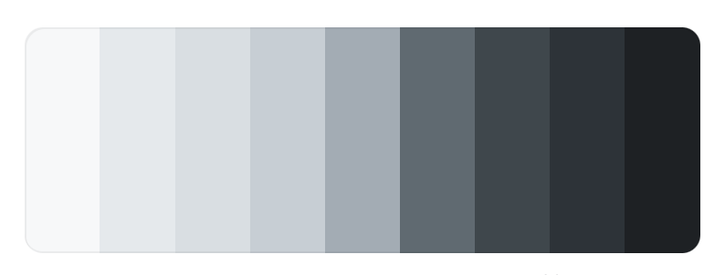
Improvement plan based on color analysis
6. Please write any suggestions to have better color harmony (2-3 sentences).
This photo needs more light tones. It can increase exposure when you take a picture. Or you can edit the photo by increasing brightness.

Slide 4
1. Monochromatic
Explain color harmony with color combination:
Write 5 hex colors with percentages:
Which color is the most used?
What is the brightest color?
What is the darkest color?

Slide 5
Improvement plan based on color analysis
6. Please write any suggestions to have better color harmony (2-3 sentences). When you see your photo, do you think that you have a full range of value? Do you have enough light tones (white)? Do you have enough dark tones (black)? If you can take a photo again, what can you improve it?

Slide 6
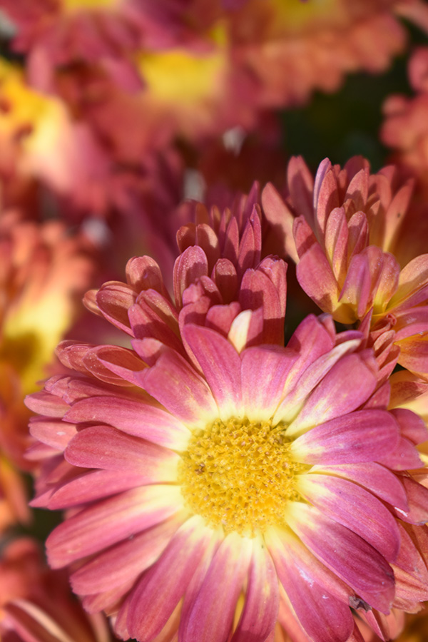
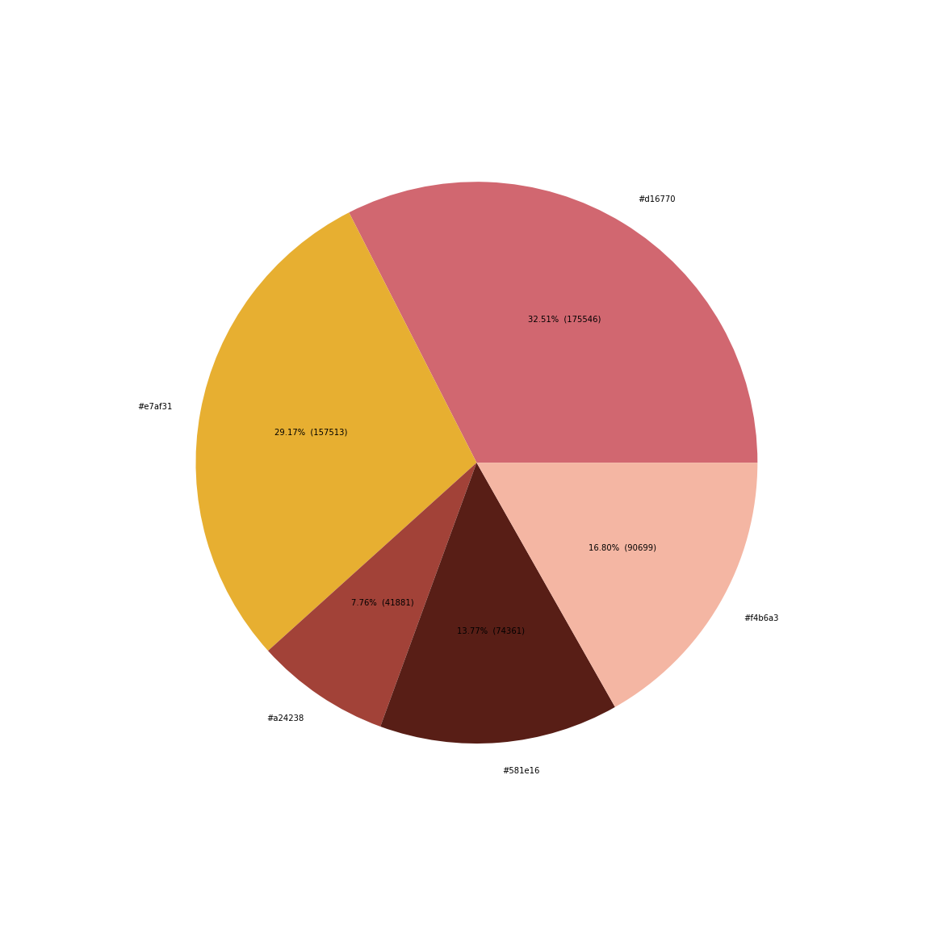
Analogous Example (delete later)
Explain color harmony with color combination: Analogous color scheme with yellow and pink.
Write 5 hex colors with percentages: #d16770(32.51%),#e7af31(29.17%),#f4b6a3(16.80%),#a24238(7.76%), #58le16(13.77%)
Which color is the most used? #d16770
What are analogous colors (color and percentage)? #d16770(32.51%),#e7af31(29.17%), #f4b6a3(16.80%)
What is the colors which are not analogous? #a24238(7.76%), #58le16(13.77%)

Slide 7
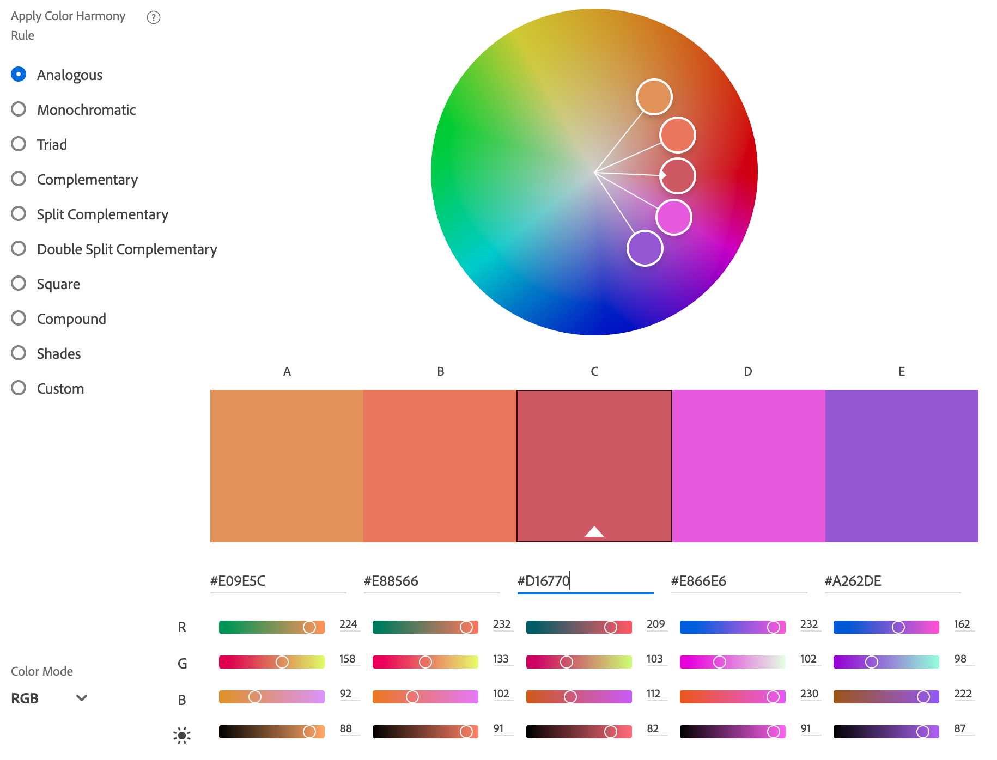
Improvement plan based on color analysis
6. Please write any suggestions to have better color harmony (2-3 sentences).
This photo used good balance and harmonies of using analogous colors. You can see #e7af3,# f4b6af, #d16770 are matched with A, B, C on the color wheel. If I want to add more colors, any purple color will be good for harmony.

Slide 8
2. Analogous
Explain color harmony with color combination: Analogous color scheme with yellow and pink.
Write 5 hex colors with percentages:
What is the color of the main subject? (color and percentage)
What are analogous colors (color and percentage)?
What is the colors which are not analogous (color and percentage)?

Slide 9
Improvement plan based on color analysis
6. Please write any suggestions to have better color harmony (2-3 sentences). When you compare your pie chart and the color wheels, which analogous colors are missing? If you can take a photo again, which color will be good to add for analogous harmony? Which color will be good to remove (background or distracting colors) for analogous harmony?

Slide 10
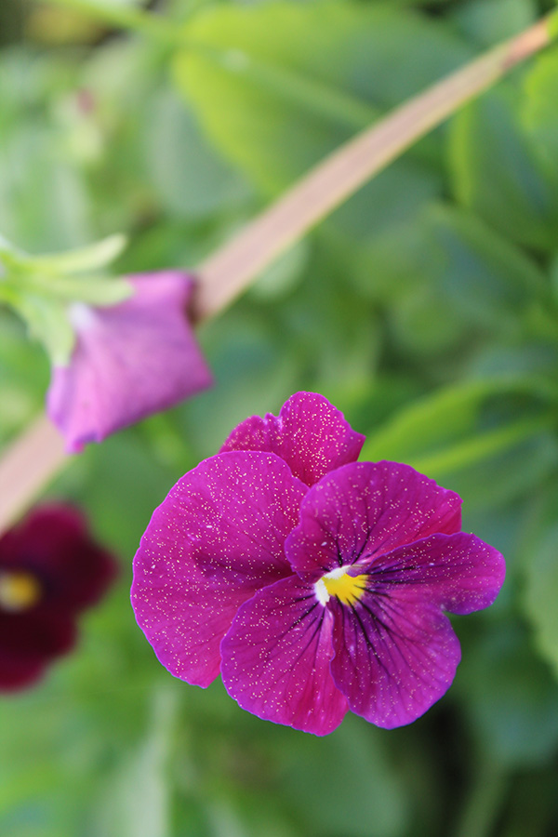
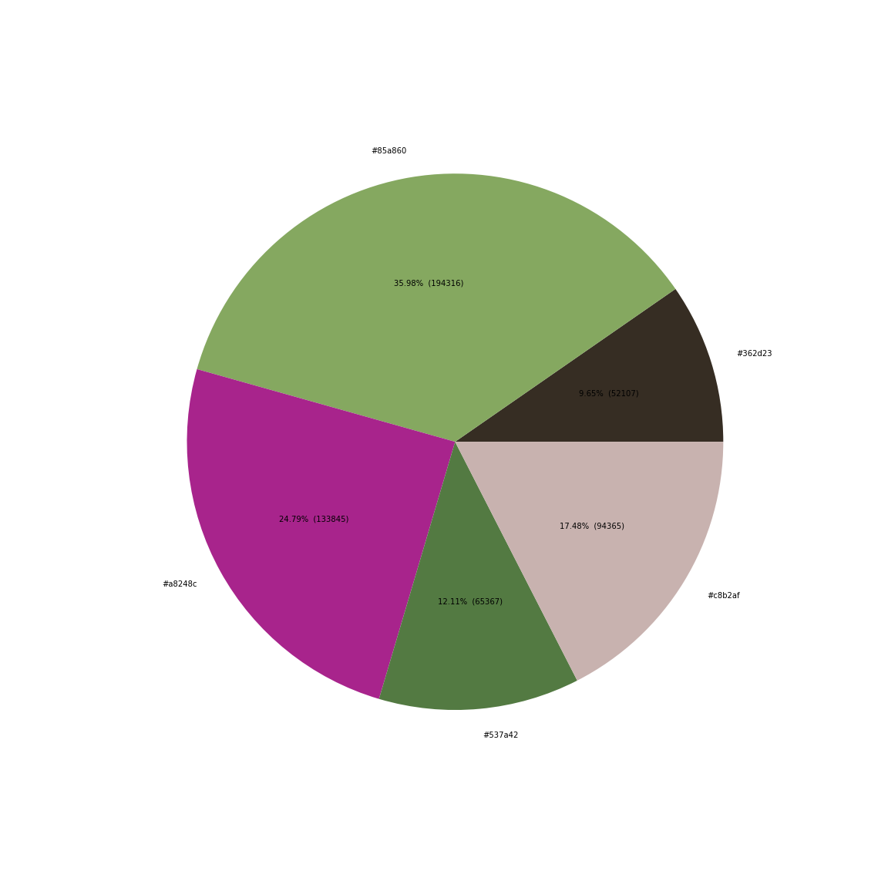
Complementary Example (delete later)
Explain color harmony with color combination: complementary color scheme with purple and green.
Write 5 hex colors with percentages: #85a860(35.98%),#a8248c(24.79%),#537a42(12.11%),#c8b2af(17.48%),#362d23(9.65%).
What is the color of the main subject? (color and percentage) #85a860(35.98%)
What are complementary colors (color and percentage)? Purple: #a8248c(24.79%), Green: #537a42(12.11%), #85a860(35.98%)
What is the colors which are not complementary (color and percentage)? #c8b2af(17.48%),#362d23(9.65%)

Slide 11
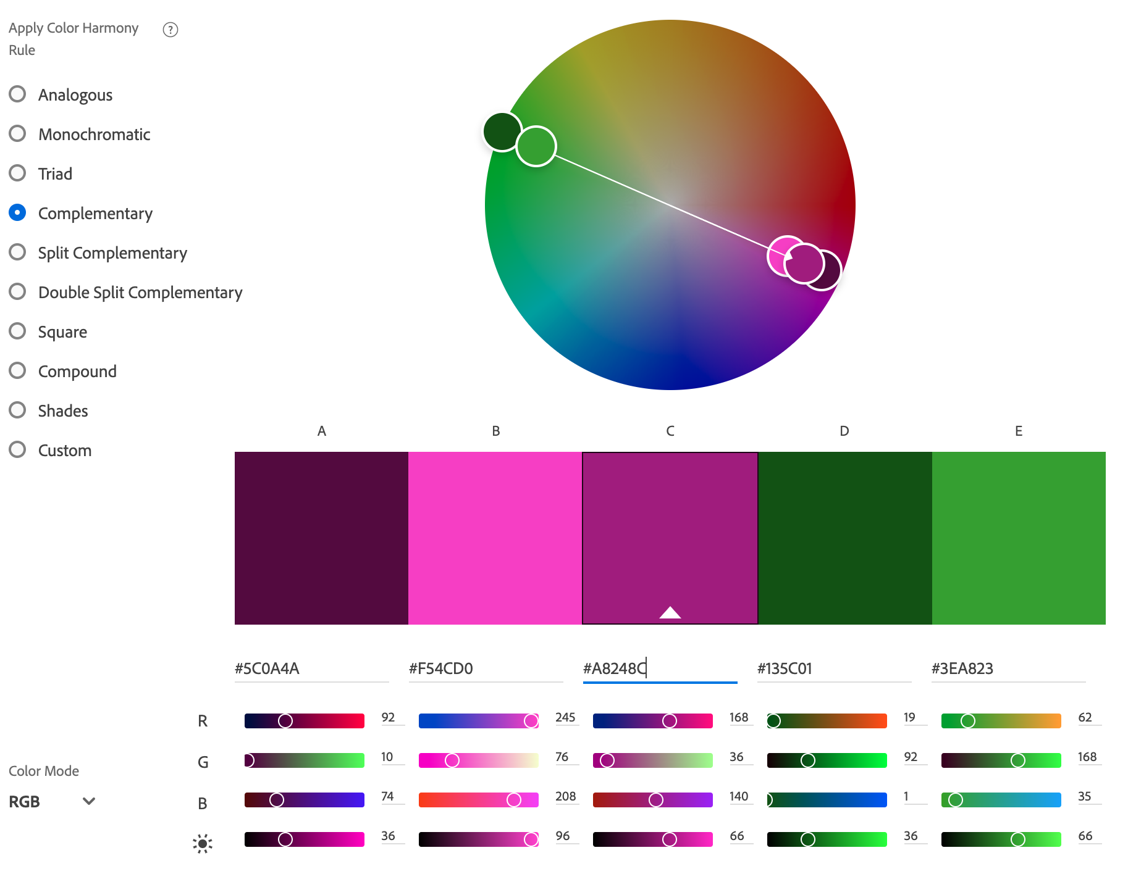
Improvement plan based on color analysis
6. Please write any suggestions to have better color harmony (2-3 sentences).
This photo has a good complimentary color scheme. The purple flower is focused and saturated to get the most attention against green background.

Slide 12
3. Complementary
Explain color harmony with color combination: complementary color scheme with orange and blue.
Write 5 hex colors with percentages:
What is the color of the main subject? (color and percentage)
What are complementary colors (color and percentage)?
What is the colors which are not complementary (color and percentage)?

Slide 13
Improvement plan based on color analysis
6. Please write any suggestions to have better color harmony (2-3 sentences). What is your complementary color of the main subject? According to the color wheel, are they complementary colors (opposite colors)? (yellow-purple, orange-blue, red-green)? If not, which color combination will be better complementary? If you can take a photo again, what do you want to change?
7. Please provide us with your valuable comments/suggestions for data science, color theory, color analysis project, or cross-disciplinary project.

